Slide 1
Indian IT ACT Section - 43 A
Compensation for failure to protect data

Slide 2
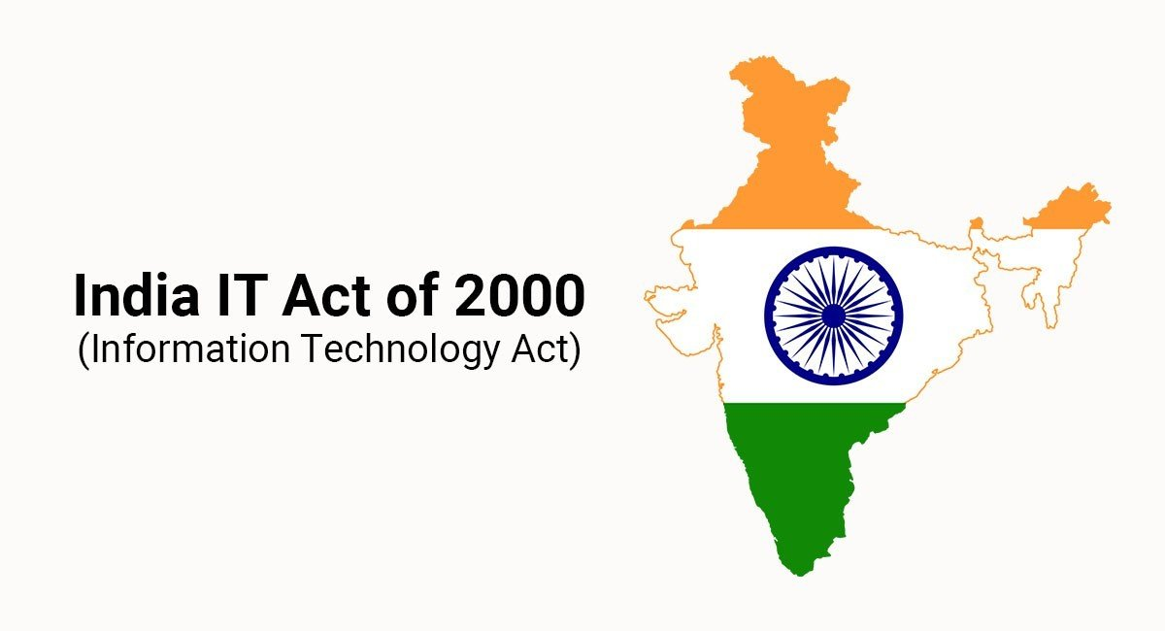
“Where a body corporate, possessing, dealing or handling any sensitive personal data or information in a computer resource which it owns, controls or operates, is negligent in implementing and maintaining reasonable security practices and procedures and thereby causes wrongful loss or wrongful gain to any person, such body corporate shall be liable to pay damages by way of compensation, not exceeding five crore rupees, to the person so affected”

Slide 3
Explanation: For the purposes of this section:
(i) "body corporate" means any company and includes a firm, sole proprietorship or other association of individuals engaged in commercial or professional activities
(ii) "reasonable security practices and procedures" means security practices and procedures designed to protect such information from unauthorised access, damage, use, modification, disclosure or impairment, as may be specified in an agreement between the parties or as may be specified in any law for the time being in force and in the absence of such agreement or any law, such reasonable security practices and procedures, as may be prescribed by the Central Government in consultation with such professional bodies or associations as it may deem fit.
(iii) "sensitive personal data or information" means such personal information as may be prescribed by the Central Government in consultation with such professional bodies or associations as it may deem fit.

Slide 4
THE SCOPE OF THE RULES
Section 43A applies to data or information “in a computer resource”. The Rules do not apply to information in the purely physical domain e.g. when information (whether or not such information is sensitive or personal) is collected in physical form and is not processed in / stored in / transmitted through an electronic/ computer media. The Rules define “Personal Information and “Sensitive personal data or information” to mean as follows: “Personal Information” means any information that relates to a natural person, which, either directly or indirectly, in combination with other information available or likely to be available with a body corporate, is capable of identifying such person. “Sensitive personal data or information” means such personal information which consists of information relating to;—
(i) password;
(ii) financial information such as Bank account or credit card or debit card or other payment instrument details ;
(iii) physical, physiological and mental health condition;
(iv) sexual orientation;
(v) medical records and history;
(vi) Biometric information;
(vii) any detail relating to the above clauses as provided to body corporate for providing service; and
(viii) any of the information received under above clauses by body corporate for processing, stored or processed under lawful contract or otherwise.
Any information that is freely available or accessible in public domain or furnished under the Right to Information Act, 2005 or any other law for the time being in force is not to be regarded as sensitive personal data or information.

Slide 5
Thank you

